Slide 1
Title
Yang Xi’s study notes
Feb 2022

Slide 2
What does “Private Equity (PE)” mean to you?
An asset class for investment
Arguably include Venture Capital, Growth Equity, Buyouts, Distressed Debt, etc
Many specialist investment strategies further fragment the asset class.
Transactions, such as Buyout, leveraged buyout (LBO), etc
Venture Capital (VC) investment is usually not considered Private Equity. VC investments are structured very differently, as a unique investment type.
PE firms that organize and invest in buyout transactions
The entire industry of buyout firms

Slide 3
Private Equity Fund
A PE fund generally buys or invests in a company with the intention that it will improve its earnings or value, by providing capital and expertise, and then sell the investment at a profit.
“private” – non-public, unlisted
“equity” – shares, as distinct from property / financial instruments
Investors in a PE fund are mainly institutional investors.
Run by managers, on terms of investment management agreement and trust deed
The PE fund sells its investment in an exit transaction
Sale of company to a 3rd party buyer
Flotation of the company on a stock exchange (IPO)
With a share buy back, to use some or all money raised to buy back the shared held by PE fund
PE funds are usually set up with a lifespan of around 10 years
Initial set of investments ➔ several exits after 3-4 years ➔ another set of investments
Many Secondary Buyouts: one fund buys the shares (equity) from another fund

Slide 4
Private Equity Fund
PE funding is used by companies of all sizes
Start-ups (VC), expansion capital, management buy-outs (MBO), public-to-private deals
In MBO, PE fund teams up with existing senior managers of the target company, to form a new company which acquires the target company.
Leveraging - borrowed funds are used in acquisition
Ranking of funds
Senior Debt, usually provided by a bank
Junior Debt (mezzanine), may be provided by a different financier
Subordinated Debt – another way PE fund to make part of its investment
May be convertible into equity
PE investors

Slide 5
Benefits and Risks of Getting VC and PE Funding
Benefits
Access to capital
Sector expertise and experience
Network and connections
Appetite for risk: a portfolio view, medium-term time horizon
Disadvantages
Loss of control and management autonomy
Lengthy and complex investment process – about 6 months for a series
Uncertainty – there is no guarantee that an investment deal will close
Risk transference to management

Slide 6
Structure of a PE firm
The General Partner (GP) is the PE firm.
GP manages the fund, makes fund investments, aligns interests of the LPs
GP commitment to a fund: the PE firm’s own cash
Typically 1%, but expected to be a meaningful amount of their personal wealth
“skin in the game” - help to align the interests
Cash – cannot be waiver of fees / indirect investment
Fully liable, including negative returns
Limited Partners (LP) – external investors
External investors, including institutional investors and accredited investors.
Passive role – no inputs to the investment decisions
Committed Capital: money raise from LP
Liable for up to the full amount they invest
Operating Partners (OP)
Individuals with operating and industry experience, who help with deal sourcing and portfolio company management

Slide 7
Structure of a PE firm
Good to know how long has a fund been setup
PE funds typically have a life-cycle of about 10 years
Investment Cycle (5 to 7 years) and Harvest (exit) Cycle (3 to 5 years)
PE funds typically aim to invest around 90% of the fund
Keep ~10% for further investment such as bolt-on acquisitions, further growth capital, etc
A fund will have a specific set of investment criteria
Different funds within a firm may have different goals and objectives
Sector / geography /investment stage / types of deal / investment size …
Firms rarely make cross fund investment
Conflicts of interest from different mix of LPs
Firms grow by raising new funds, as existing funds approach maturity and full investment (closed).
Funds typically charge 2% annual management fee on committed capital.
Usually 20% carried interest, and LPs share 80% of the return
Hurdle rate, usually 7% to 10%, much be achieved on-behalf of the LPs, before the GP can take some or all the performance related carried interest.
Any need to identify such criteria?

Slide 8
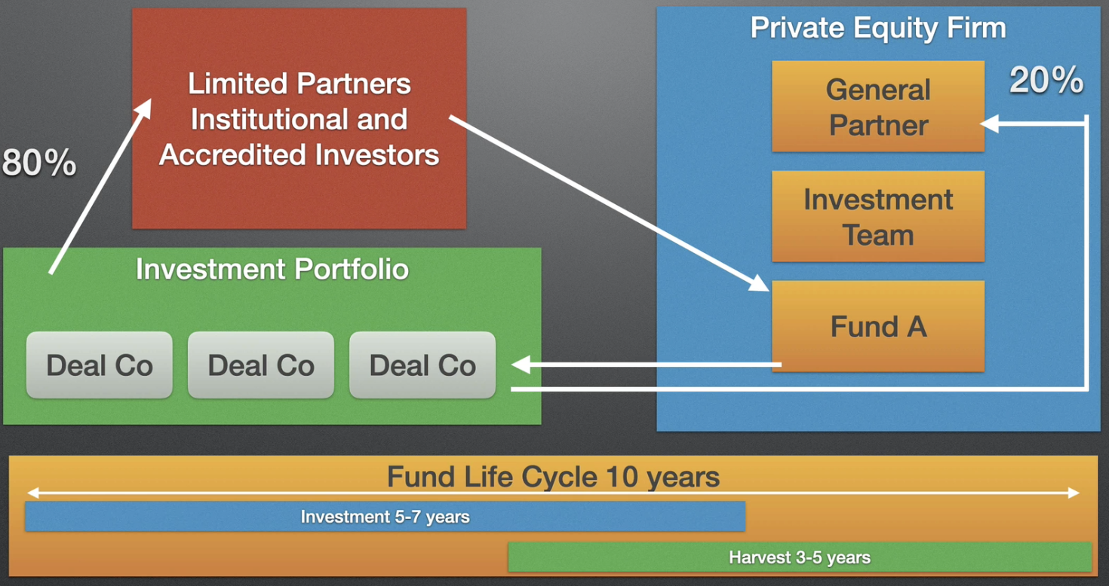
Structure of a PE firm

Slide 9
Limited Partnerships (LP) in PE
When the Fund is raised, GP and LPs sign a Limited Partnership Agreement
LP Clawback Clause: in case that the Fund does not have enough assets to meet liabilities, GP can claw back distributions already paid to the LPs to meet these liabilities
The LPA also outlines the duration of the Fund (~ 10 years). Funds are highly incentivized to exit within this cycle
Organization and Formation
Fund Raising ~ 2 years
Deal Sourcing and Investing ~ 3 years
Portfolio Management
Harvesting (exiting) ~ up to 7 years
Investment criteria: industry, stage, deal type, geography, etc
Limits the maximum investment per company
Key Person Clause: allows the investment to be paused if key person changed
Advisory Board: Consist of LP members, appointed by GP, to give advice, especially
Conflict of interest, Fund term extensions, amendments to the LPA
Is LPA public?

Slide 10
Executive Roles in a PE Firm
PE firms tend to be much smaller than Investment Banks (IB). The organizational structure is usually flat.
Senior roles usually cover
Deal origination, Negotiation & Closing
Portfolio Management, Investment Decision Making
Fundraising
Compliance

Slide 11
Investors
Incubator: an organization provides start-up companies with space and resources
limited amount of cash (like 20 to 30 K)
Mentorship, network introductions, help with finding strategic partners and investors
Bootstrap: funding your startup from your own resources
Angel Investor
Typically high net worth individuals (HNI); not professional VC / PE
Use their own money, invest maybe $250 K to $500 K
Seek for large portion of equity (like 33%), often want to go on the board
Venture Capital
The first tranche of professional investors
Typically take a minority investment in high-growth early-stage companies
Usually companies post revenue, but pre-profit/positive cash flow
With negative cash flow – no access to debt – need VC investment
High risk, high return
“bad” financials can be seen as opportunity

Slide 12
Investor
Growth Equity
A PE firm makes minority/majority investment in an early-stage company
Aiming to transform less mature companies into market leaders
Usually target companies with proven product to be scaled
Mezzanine Finance – provided by specialist PE funds
Focus on junior/subordinated debt – ranked below senior debt, above PE funds
Yield 15% +, often with equity kicker warrants (convert to equity/indeed options)
Used to fill funding gaps, when senior debt is not being offered to the extent required by the lead PE investor
PE firms – range of firms focusing on various investment strategies
Investment size can be from millions to billions
Core center of the buyout market
Prove product to be scaled

Slide 13
Investors
Family Office - Investment firm established by a wealthy family
Manage assets and investments of the family
Long time horizon - not very focus on realization, but to build up asset portfolios
Strategic Investor
An established company invests in early-stage companies to gain access to new technology / business model
Often come in in-place-of a VC / a joint venture structure / option or intention to acquire the company
Give the founders the opportunity to grow the business before they bring it in-house
Corporate Venture Capital (CVC)
Established companies investing, either opportunistically or as part of a formal program, targeted at early-stage business often with innovative technology
Also a way to prevent competitors to take the technology
Crowdfunding (kickstarter, indiegogo)
An effective way since the last 5-10 years, for startup companies to raise small amounts from large number of non-professional investors, on very informal terms
New technology

Slide 14
Management Buyout (MBO)
A deal in which a business is bought from its owners by its management team, financed by a PE firm.
Common opportunities
Corporate restructuring – to buy the non-core business spun out
Sellout by the controlling shareholders / founders
Sale of the viable part of business, from a collapsed business, by a Receiver / Administrator
Parties in the deal – each has own agenda / priorities / interests / expectations
The seller
The Special Purpose Vehicle (SPV) company formed to make this acquisition
PE and 3rd party funders (usually banks)
Buyout Team – formed by different people within the party
Due Diligence Advisers (lawyers & accountants) – advise the buyers to check the quality and the correctness of the business they are buying
Financial Advisers
Tax Advisers
Legal
…

Slide 15
Management Buyout (MBO)
Funding
Debt / Equity / Working Capital Facilities (loans and overdrafts)
Banks normally provide debt funding
Amount varies from each deal – can be below 10% or above 70%
Banks usually seek to get security over assets – low risk
Earn interest payments and principle repayments
Private Equity (PE)
Maybe 40-50%
Alongside management, control relationship through Shareholder Agreement, which gives them rights and vetos
Management Equity
Usually the smallest amount, like 5-10%, but structured with highest potential capital gain
For the management to have a skin in the game
MBO provides the management with the opportunity to make a substantial capital gain for a relatively modest investment - driven by the management

Slide 16
Leveraged Buyout (LBO)
The core components of LBO are the same as MBO
The core difference:
While an MBO is driven by the management team, An LBO is driven by the PE firms and their financial goals.
The basic idea
Use debt to leverage (multiply) the power of your cash (your own equity)
When you sell, you have used the cash from the business to pay down the debt
This can greatly enhance the value of your original equity investment

Slide 17
More opinions to the MBO myths
The management does not need to contribute millions $ in MBO – the banks and PE firms will provide the bulk of the finance.
This is usually structured and organized by the corporate advisors, normally an IB
MBO can have an advantage over Trade Buyers, especially when the seller is the founder of the business, who trends to prefer the existing management
Investor prefer balanced team – experience, track record, leadership – not necessarily extraordinary
MBOs have been seen succeed in almost all sectors.
Average MBO size in UK is about 25m pounds - medium sized companies, divisions / subsidiaries of large companies
MBOs are not necessarily more risky than other deals.
How to define balanced team?

Slide 18
Buyout Terms
Leveraged Buyouts (LBO) – this terms applies to a variety of deal types
Most generic – LBO is a deal predominantly funded by debt (leverage)
Typically more mature and established business
Involve the controlling acquisition and majority acquisition by a PE / buyout firm
Corporate Carve Out
A company, often public, sells a non-core division/assets
Management Buyout (MBO)
Transaction led by the existing management to buy the parent company with the help of a PE firm
Management Buy-In (MBI)
Transaction led by an external management to come-in and buyout the business
High risk – new management will not have intimate knowledge of the business before the deal closes.

Slide 19
Buyout Terms
BIMBO – combination of MBO and MBI
External senior executive teams up with the existing management to buyout the company with funding from a PE firm
Middle Market Buyouts
Buyout market of the “middle market companies” – about $25m to $1bn revenue
Generic to deals around this size, not refer to any strategy
JAMBOG - Just Another Middle Market Buyout Group
Not very polite term, often used by Limited Partners (LP), referring to a middle market buyout firm failed to differentiate itself in the market

Slide 20
Buyout Terms – Secondary Transactions
Secondary Buyout
Company already funded by a PE firm, is sold to another PE firm
Not sold to a strategic / trade purchaser
Advantage – provide direct liquidity for the seller, without need of IPO / trade sale
There are specialist firms focusing on secondary transactions
Direct Secondary Transaction
The stockholder, in a private company funded by a PE firm, sells its stake to another individual / LP / PE firm
LP Secondary / Fund Secondary
An LP sells its LP interest in the Fund / company, to a 3rd party
Synthetic Secondary
An LP sells its economic interest (and liabilities) without transferring legal ownership
Secondary transactions can also take place when a 3rd party LP wants to buy into a PE fund. They can also occur purely for capital / cash flow / portfolio balancing reasons
Secondary Buyout – a previous buyout can bring attention

Slide 21
Investment Terms
Development Capital / Growth Capital / Expansion Capital / Growth Equity
Minority investments by PE firms to help companies scale
Other first institutional round of investment – Series A
Take Private / Public to Private
Acquisition of a public company by a PE firm
Bridge Finance / Bridge Loan
Usually used to fulfill short-term financing need
Money made available to a company by investor, until the next financing round
Normally structured as convertible debt, and convert into the investment round
Club Deal – two PE firms team up to invest in a company
Can be for financial reason, or complimentary expertise
Co-investment / Direct Investment
An LP invests directly into the company along side the PE firm, not through the fund

Slide 22
Investment Terms
PIPE – Private Investment in Public Equity
A predominantly been limited to the US market
Often an un-quoted instrument, created by the public company, for the PE firm, structured to delivery PE level investment return
Enable the public company to access PE funds in a uniquely structured transaction
Often used for a particular strategy / reason
Roll Up / Buy and Build
A PE investment strategy – the PE firm initially buys a “platform company”, and then makes a series of acquisitions of its competitors
Target to achieve market leadership / higher returns from economies of scale
Bolt On / Add On
Similar to Buy and Build, but more opportunistic – may be a one-off M&A transaction
Alternative Assets / Alternative Investments
A broad term for assets not cash / bonds / publicly quoted equity
Such as hedge funds, commodities, derivatives, etc.
Also include PE, VC, buyouts, mezzanine, etc.

Slide 23
Investment Terms
Money In
A development capital transaction, where money is put into the company by a PE firm
Money Out
PE firm acquires directly stock from a business owner, who takes the money out of the company (and puts into his own bank account)
Follow On Investment
An investor who has made an initial investment, invests in the next financing round
Often used to avoid being diluted in the deal
Often a right (option) specified in the terms of the original financing
Turnaround
A specialized investment in a financial distressed company, target to restore profitability
Initial cost is low, and the objective is clear – but can incur considerable cost because of financial and legal complexity

Slide 24
Investment Terms
Committed Capital
Total fund size – all commitments made by the LP
PE funds operate on a committed capital basis
Management fees are calculated on committed capital
Called Capital
Total amount actually paid-in by the LPs at a point in time
There is initial capital call, then over periods of time, further capital calls
Uncalled Capital = Committed Capital – Called Capital

Slide 25
Investment Terms
Users of PE firms data
Funds of Funds
PE funds which invest into other PE funds
Usually “Blind Pools” – when an LP invests in the Fund of Funds, it will not know which PE funds this Fund of Funds will take position in
Benefits to LP
Diversification
The investment team provides expert analysis of the targeted funds
Often have strategic / geographic specialization
Remove administrative burden – capital calls, capital distributions of all forms
Allow a small LP to gain access to wide range of PE funds
Good for new LP to get onboard PE asset class
Problems
Pay two sets of management fees
Diversification can lower the risk, but also lower the return
LP will have less access/relationship to the fund managers in the PE funds
May have longer and deeper J-Curve – negative returns at early stages before turning positive
LP will have less information of the companies getting invested
Less liquid (greater discount risk) compared to LP in PE funds, which has a secondary market

Slide 26
A
A

Slide 27
A
A

Slide 28
A
A

Slide 29
A
A

